Slide 1

Dr. Rishi Pal
Asstt. Professor

Slide 2
Cough
Protective reflex.
Intended to remove irritants and accumulated secretion.
Types of cough:
1. Productive cough: helps to clear the airway, suppression is harmful may leads to infection.
2. Non productive cough: Useless and should be suppressed.

Slide 3
Anti-cough agents
Antitussives (cough center suppressants): codeine. Pholcodeine, noscapine, dextromethorphan, antihistamines, benzonate.
Pharyngeal demulcents: logenges, linctuses, liquorice.
Expectorants: sodium and potassium citrate, potassium iodide, guaiphansin, ammoniumchloride.
Mucolytics: bromhexine, acetylcysteine, carbocisteine, ambroxol.

Slide 4
Antitussives
Inhibits cough reflex by suppressing cough center in medulla.
Used for symptomatic treatment of dry unproductive cough.
Codeine:
Cough center suppressant effects.
Cause mild CNS depression.
Constipation by decreasing intestinal movements.
Should be avoided in children and asthmaticus.
Administered orally, mild analgesic, less addiction.

Slide 5
Antitussives…
Pholcodeine:
Similar action as codeine
No analgesic.
No addiction liability.
Administered orally.
Has long duration of action.
Noscapine:
Opium alkaloid.
Potent antitussive effect.
Useful in spasmodic cough.
No analgesic effect.
Does’t cause constipation, CNS depression or addiction
Side effects are nausea and headache.

Slide 6
Antitussives…
Dextromethorphan:
Centrally acting antitussive agent.
No analgesic property.
Does’t cause constipation and addiction; mucuciliary function is not affected.
Antihistamines:
Diphenhydramine, chlorpheniramine, promethazine are useful in cough because:
Sedative, antiallergic, anticholinergic effects.
Produce symptomatic relief in cold and cough associated with allergic condition of respiratory tract.

Slide 7
Antitussives…
Benzonatate
It is a peripherally acting cough suppressant and chemically related to local anesthetic procaine.
Acts on the pulmonary stretch receptors.

Slide 8
Pharyngeal demulcents
Syrups
Logenges
Linctuses or liquorice
These are uses when cough arises due to irritation above larynx.
Increase salivation.
Produce protective soothing effect on inflamed mucosa.

Slide 9
Expectorants (mucokinetics)
Increase volume of bronchial secretion.
Reduce viscosity of the sputum.
So cough becomes less tiring and productive.
Includes: iodides, chlorides, bicarbonates, acetates, volatile oils.
They are used in the chronic cough.

Slide 10
Mucolytics
These agents break the thick tenacious sputum.
Lowers viscosity of sputum.
So the sputum comes out easily with less effort.
Bromhexine
It liberates lysosomal enzymes which digest mucopolysaccharide, hence decrease viscosity of sputum.
Side effects are rhinorrhoea and lacrimation.

Slide 11
Mucolytics…
Acetylcysteine and carbocysteine
Used as aerosol in the treatment of cough
Open disulphide bond in mucoprotein of sputum, so the sputum becomes.
Side effects are nausea, vomiting and bronchospasm.
Carbocysteine is administered orally.

Slide 12
Bronchial asthma
Impairment of airflow due to construction of bronchial smooth muscle (bronchospasm)
Swelling of bronchial mucus secretion.
Factors:
Allergy, infection, psychological factors,
Air way obstruction may be due to release of the mediators from sensitized mast cells in the lungs.

Slide 13
Bronchial asthma…
Acute asthma
Chronic asthma
Status asthmaticus (acute severe asthma)

Slide 14
Drugs for broncial asthma…
Histamine
5-HT (serotonin)
Prostaglandins
Leukotriens (LTC4 and LTCD4)
Protease
Platelet activation factor (PAF)
Bronchial asthma may be episodic or chronic.

Slide 15
Classification of antiasthmatic drugs
1. Bronchodilators
A. Sympathomimetics:
i) Selective B₂-adrenergic agonists: salbutamol, terbutaline (short acting), salmeterol, and formetrol (long acting).
ii) Non selective : adrenaline
B. Methylxanthine: theophylline, aminophylline, etophylline

Slide 16
Classification of antiasthmatic drugs….
C. Anticholenergics: Ipratropium bromide, tiotropium bromide.
2. Leukotriene receptor antagonist: zafirlukast, montelukast.
3. Mast cell stablizers: sodium chromoglycate, nedochromil sodium, ketotifen.
4. Glucocorticoids:
Inhaled glucocortecoids: beclomethasone, budesonide, fluticasone.
Systemic glucocortecoids: hydrocortisone, prednesolone, methylprednesolone.
5. Anti-Ig-E monoclonal antibody: omalizumab.

Slide 17
Bronchodilators
Adrenaline: produce prompt and powerful bronchodilation by acting through β₂ adrenergic receptors.
Useful in acute attack of asthma (0.2-0.5 ml of 1:1000 solution given s.c.
Its use decline due to serious cardiac side effects.

Slide 18
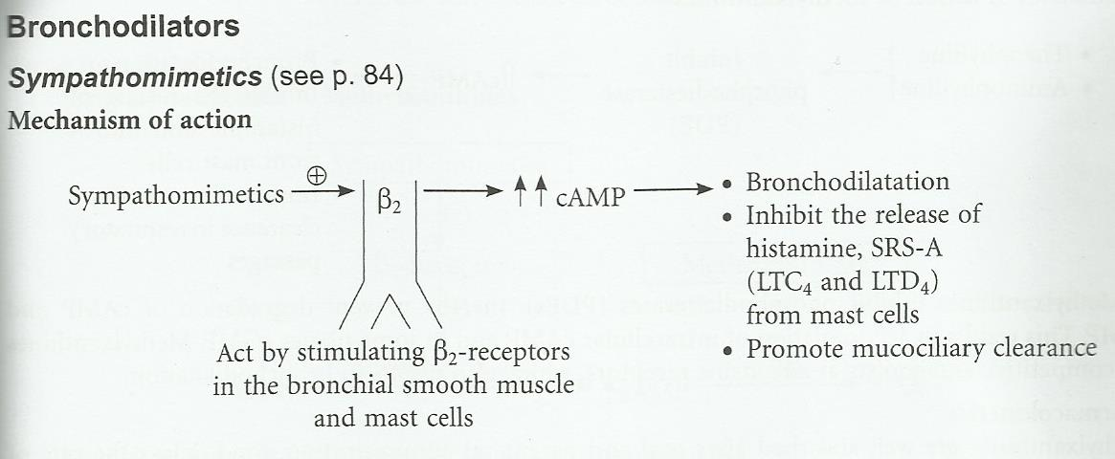
Mechanism of bronchodilation…

Slide 19
Bronchodilators…
Selective β₂- adrenergic agonists
The first line drugs for bronchial asthma.
Well tolerated when inhaled.
At high doses may cause tremor, tachycardia, palpitation, hypokalaemia.

Slide 20
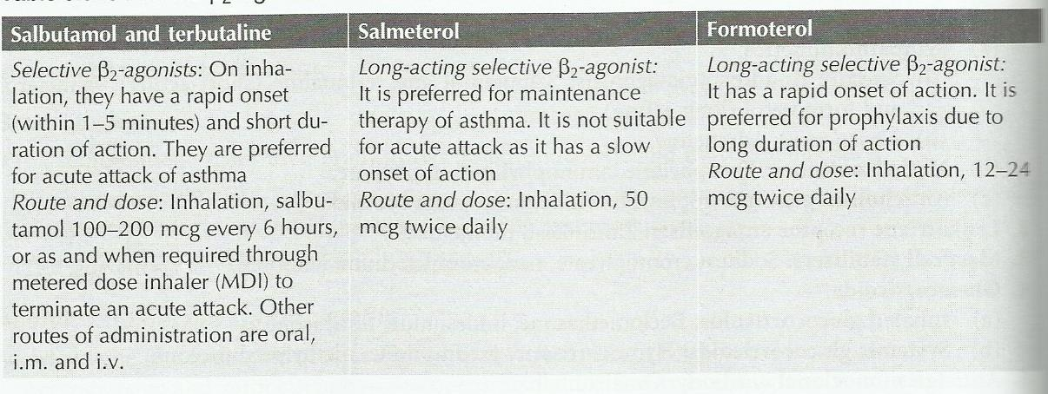
Bronchodilators…

Slide 21
Bronchodilators…
Methylxanthines:
Their uses are markedly reduced due to their narrow therapeutic index and available of better antiathmatic drugs.
Methylxanthine are third or fourth line drugs in the treatment of asthma.
Methylxanthines are well absorbed after oral and parenteral administration.
Food delays the rate of absorption of theophylline, well distributed, cross placenta & BBB, metabolised in liver and excreted in urine.

Slide 22
Methylxanthine Bronchodilators…
Theophylline: poorly water soluble, hence not suitable for injection, available for oral administration.
Aminophylline: water soluble but highly irritant. Administered orally or slow i.v.
Etophylline: given by oral, i.m., i.v. routes.
Adverse effects: have narrow margin of safety, tachycardia, palpitation, hypotension, death due to cardiac arrhythmias.

Slide 23
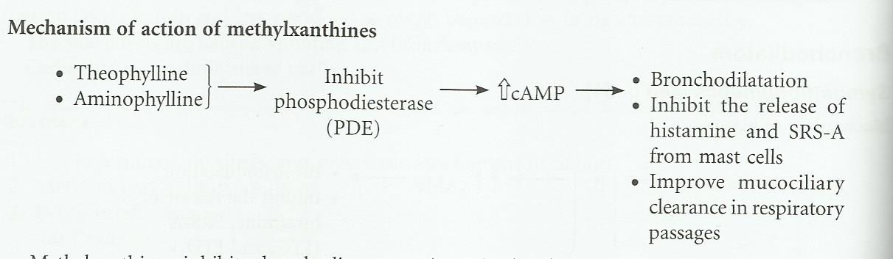
Mechanism of action of methylxanthine

Slide 24
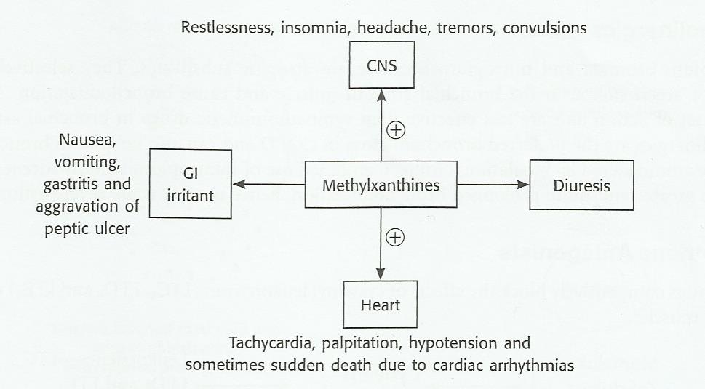
Adverse effects of methylxanthine

Slide 25
Drug interactions with methylxanthines
Drug interactions
Phenytoin/ rifampicin/phenobarbitone x theophylline
Cimetidine/ciprofloxacin/erythromycin x theophylline.
Uses:
Bronchial asthma and COPD
Premature apnoea in infants.

Slide 26
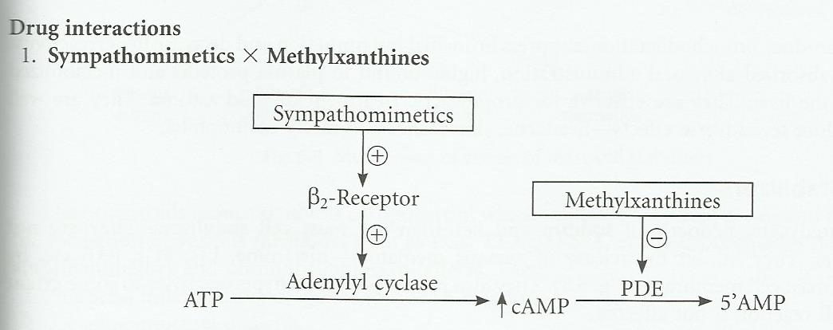
Drug interactions

Slide 27
Anticholinergics
Ipratopium bromide and tiotropium bromide are atropine substitutes.
Selectively blocks the effects of Ach in bronchial smooth muscle and cause bronchodilation.
Slow onset of action and are less effective.
These drugs are preferred in COPD.
Administered by inhalation route.
Combination with B₂- adrenergic agonist have better effects.

Slide 28
Leukotriene antagonists
These drugs competitively blocks the effects of cysteinyl leukotrienes (LTC4, LTD4, LTE4) on bronchial smooth muscle.
Produce bronchodilation.
Suppress bronchial inflammation
Decrease hyper-reactivity
Well absorbed after oral administration.
Highly bound to plasma protein.
Effective in prophylactic treatment of mild asthma.
Well tolerated and has less side effects.

Slide 29
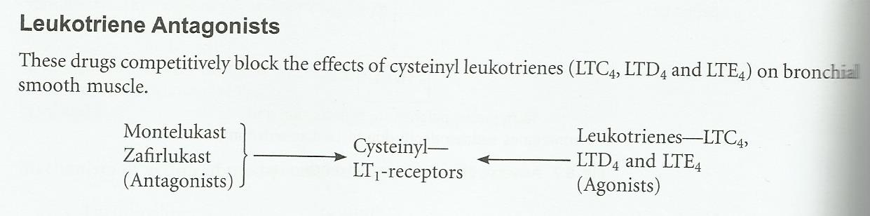
Mechanism

Slide 30
Mast cell stabilizers
Sodium chromoglucate, nedocromil sodium, kitotefen.
They are not bronchodlators.
Inhibits release of various mediators-histamine, LTs, PGs PAF etc.
Stabilizes the mast cell membrane.
Sodium chromoglycate: is not effective orally as it poorly absorbed from gut, given by inhalation route.

Slide 31
Mast cell stabilizers….
Uses of sodium chromoglycate
As prophylactic agent to prevent bronchospasm induced by allergens and irritants.
Can be used in allergic conjunctivitis, allergic rhinitis, allergic dermatitis, etc.
Used by topical route as prophylactic agent.

Slide 32
Mast cell stabilizers…
Nedocromil sodium: mechanism of action pharmacological effects are similar to sodium chromoglycate.
Approved for use in patients above 12 years of age in bronchial asthma.
Ketotefen: mechanism is similar to sodium chromoglycate, has H₁-blocking effect. It is orally effective but has a slow onset of action.

Slide 33
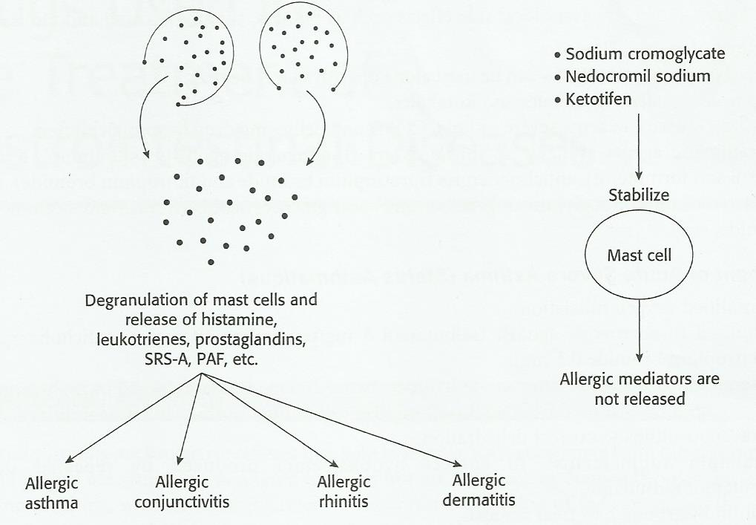
Mechanism

Slide 34
Glucocorticoids
Systemic: hydrocortisone,prednisolone, methylprednisolone, and others
Inhalational: beclomethasone, budesonide and fluticasone.
Glucocoticods secrete lipicortin which inhibits phospholipase A₂ and thereby prevent formation of various mediators such as PGs, TXA₂ etc.
Have antiallergic, antiinflammatory and immunosuppressant effects.

Slide 35
Glucocorticoids…
Suppress inflammatory response to Ag: Ab reaction.
Decrease mucosal oedema.
Reduced bronchial hyperreactivity.
Do not have direct bronchodilating effect but potentiates the effects of B-adrenergic agonists
They are well tolerated.

Slide 36
Glucocorticoids…
Combination of long acting b-agonists (LABA) with steroid is available, e.g. fluticasone + salmeterol; budesonide + formetrol.
They have synergistic action used in COPD and bronchial asthma.
Adverse effects: gastric irritation, Na⁺ and water retention, hypertension, muscle weakness, osteoporosis, HPA-axis suppression etc.

Slide 37
Anti-Ig-E antibody
Omalizumab: prevents binding of IgE to mast cell, thus prevent mast cell de-granulation.
It has no effects on IgE already bound to mast cells.
Administered parenterally.
Used in moderate to severe asthma and allergic disorders such as nasal allergy, food allergy, etc. approved for use in patient above 12 years of age.

Slide 38
Inhalational devices
Metered dose inhaler (MDI)- used with spacer device.
Dry powder inhalers- spinhaler and rotahaler
Nebulizers- useful in acute severe asthma, COPD, and children.

Slide 39
Treatment of acute severe asthma
Humidified oxygen
Nebulized β₂- adrenergic agonist (salbutamol 5 mg/terbutaline 10 mg) + anticholinergic agents (ipratropium bromide 0.5 mg).
Systemic glucocorticoids: i.v. hydrocortisone 200 mg stat followed by 30-60 mg prednisolone/day.
I.V. fluid to correct dehydration.
K⁺ and sodium bicarbonates supplements.
Antibiotics.

Slide 40
Dugs to be avoided in asthma
NSAIDs
β-adrenergic blockers.
Cholinergic agents.

